Slide 1
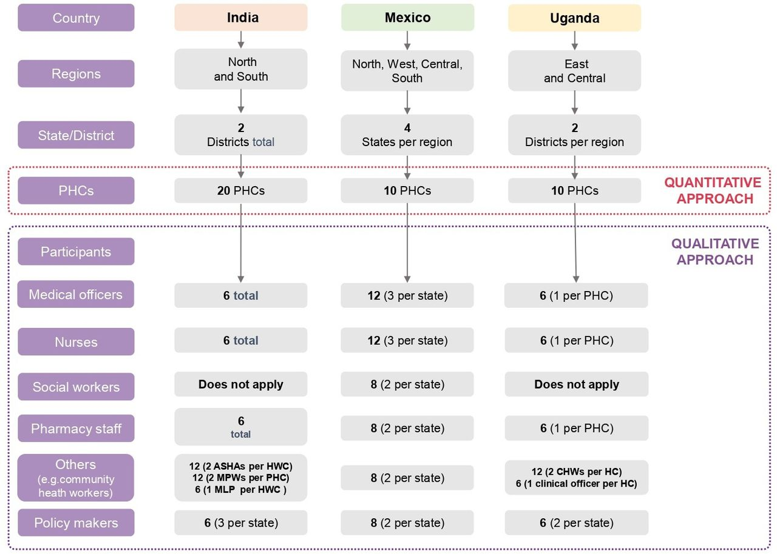

Sample level distribution and methodological approach.
Rohina Joshi et al. BMJ Open 2022;12:e055218
©2022 by British Medical Journal Publishing Group
Notes:
Sample level distribution and methodological approach. HC, Health Care; HWC, Health and Wellness Centre; MLP, Mid Level Provider; MPW, Multipurpose Health Worker; PHC, primary healthcare.

